Slide 1

Trends in Graphic Design: A Minimalist's Guide
Welcome! This presentation will explore current and past trends in graphic design, including: Minimalism: Less is more! Flat Design: Simplicity and usability. Skeuomorphism: Design mimicking real-world objects (and why it's often out). Other Emerging Trends: Gradients, 3D, and more!
1

Slide 2
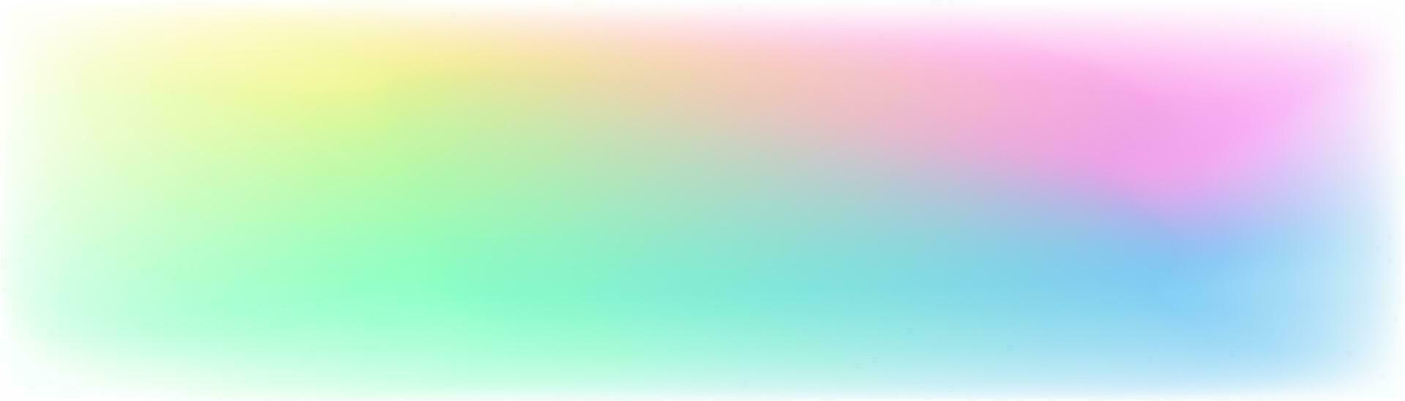
What are Graphic Design Trends?
Graphic design trends are the popular styles, techniques, and aesthetics that are currently being widely adopted by designers. They influence everything from website layouts to logos and advertising.
2

Slide 3
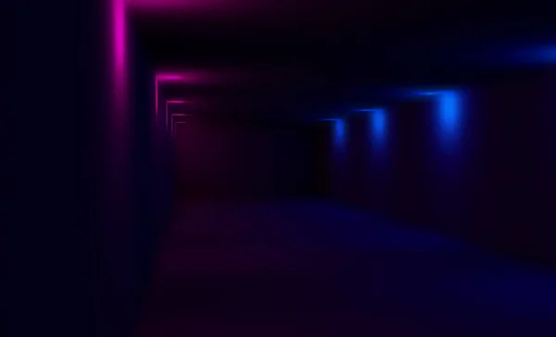
Minimalism: The Art of Less
Minimalism focuses on: Simplicity: Stripping away unnecessary elements. Clean Lines: Using clear and defined shapes. Negative Space: Utilizing empty areas for emphasis. Limited Color Palettes: Often using 2-3 colors or monochrome schemes. Think of it as Marie Kondo for your design!
3

Slide 4
Examples of Minimalism
Simple logos with just a few lines. Websites with lots of white space and minimal text. Posters with a single strong image and minimal typography.
4

Slide 5

Flat Design: No Depth, All Clarity
Flat design eschews three-dimensional effects like shadows, gradients, and textures. It emphasizes: Solid Colors: Bold and vibrant hues. Simple Shapes: Geometric forms and icons. Usability: Easy to understand and navigate. Think of it like a vector illustration brought to life.
5

Slide 6
Benefits of Flat Design
Faster Loading Times: Simpler graphics mean smaller file sizes. Responsive Design: Scales well across different devices. Accessibility: Easier to understand for users with cognitive disabilities.
6

Slide 7
Skeuomorphism: Mimicking Reality
Skeuomorphism designs elements to resemble real-world objects. Examples include: Leather textures on calendar apps. Shadows on buttons to make them appear 'clickable'. Page-turning animations in e-readers.
7

Slide 8
The Rise and Fall of Skeuomorphism
Skeuomorphism was popular when digital interfaces were new, helping users understand digital functions by relating them to familiar objects. Now, users are more familiar with digital interfaces so less inclined to skeuomorphism. For instance, the camera icon in every phone resembles a real life camera in hopes of teaching users the function of the button when the smart phone was first designed.
8

Slide 9
Why Skeuomorphism Faded
Performance Issues: Complex textures and effects could slow down devices. Cluttered Interfaces: Too much visual noise made designs feel overwhelming. Lack of Scalability: Harder to adapt to different screen sizes.
9

Slide 10
Beyond Minimalism & Flat: Gradient Revival
Gradients are back! From subtle color transitions to bold, vibrant blends, they add depth and visual interest. Duotone: Using two colors for a striking effect. Abstract Gradients: Creating unique and eye-catching backgrounds.
10

Slide 11
3D Design: Adding Dimension
3D elements are becoming more prominent, especially in illustrations and user interfaces. Realistic Renderings: Creating lifelike visuals. Abstract 3D: Using 3D shapes in a more artistic way.
11

Slide 12
The Metaverse and Design
The rise of the metaverse and VR/AR technologies is influencing design. We're seeing a greater emphasis on: Immersive Experiences: Creating environments that feel real and engaging. Interactive Elements: Designs that respond to user input. 3D Modeling and Animation: Essential skills for metaverse design.
12

Slide 13
Bold Typography: Making a Statement
Large, expressive typography is a great way to grab attention. Consider: Serif Fonts: Returning for a vintage feel. Handwritten Fonts: Adding a personal touch. Variable Fonts: Offering flexibility in weight and style.
13

Slide 14
Asymmetrical Layouts: Breaking the Grid
Moving away from rigid structures to create more dynamic and visually interesting designs. Unbalanced Compositions: Deliberately creating visual tension. Overlapping Elements: Adding depth and complexity.
14

Slide 15
Animated Logos: Bringing Brands to Life
Subtle animations can make a logo more memorable and engaging. Micro-interactions: Small animations that respond to user actions. Looping Animations: Continuous animations that add visual interest.
15

Slide 16
Retro Design: A Nostalgic Return
Drawing inspiration from past decades, like the 70s, 80s, and 90s. Vintage Color Palettes: Using muted and earthy tones. Retro Typography: Classic fonts and styles. Grainy Textures: Adding a vintage feel.
16

Slide 17
Inclusive Design: Design for Everyone
Creating designs that are accessible and usable for people with disabilities. Color Contrast: Ensuring sufficient contrast for readability. Alt Text for Images: Providing descriptions for screen readers. Keyboard Navigation: Making websites usable without a mouse.
17

Slide 18
Micro-interactions: Delight in the Details
These are small, subtle animations that provide feedback to users and enhance the overall experience. Examples: A button changing color when hovered over. A progress bar filling up during a loading process. A subtle animation when liking or favoriting something.
18

Slide 19
Dark Mode: Easy on the Eyes
Dark mode interfaces are becoming increasingly popular. Benefits include: Reduced Eye Strain: Especially in low-light environments. Battery Savings: On devices with OLED screens. Aesthetic Appeal: A sleek and modern look.
19

Slide 20
Isometric Illustrations: A Stylized Perspective
These illustrations create a 3D effect without using perspective. This makes them: Visually Appealing: A unique and eye-catching style. Easy to Understand: Simplified representations of complex objects. Versatile: Suitable for various applications, from websites to infographics.
20

Slide 21
The Importance of User Experience (UX)
All design trends should prioritize UX. A beautiful design is useless if it's not functional and easy to use. User Research: Understanding your target audience. Usability Testing: Evaluating how users interact with your designs. Iteration: Continuously improving your designs based on feedback.
21

Slide 22
Staying Up-to-Date
Graphic design is constantly evolving! Stay informed by: Following Design Blogs and Social Media: Sites like Dribbble, Behance, and Designspiration. Attending Conferences and Workshops: Learning from industry experts. Experimenting with New Techniques: Trying out different styles and tools.
22

Slide 23
Tools of the Trade
Here are some essential tools for graphic designers: Adobe Photoshop: For photo editing and image manipulation. Adobe Illustrator: For creating vector graphics and logos. Adobe InDesign: For layout and publishing. Figma/Sketch: For UI/UX design.
23

Slide 24
Accessibility Considerations
Always design with accessibility in mind: Use sufficient color contrast. Provide alternative text for images. Ensure keyboard navigation is intuitive. Use clear and concise language.
24

Slide 25
The Future of Graphic Design
The future is exciting and ever-changing. Expect: More AI-Powered Design Tools: Automating tasks and generating creative ideas. Greater Emphasis on Personalization: Tailoring designs to individual users. Continued Evolution of Digital Interfaces: Exploring new ways to interact with technology.
25

Slide 26
Key Takeaways
Trends evolve, but good design principles endure. Prioritize usability and accessibility. Stay curious and keep learning. Don't be afraid to experiment and break the rules!
26

Slide 27
Thank You!
Thank you for attending! I hope this presentation has given you a better understanding of current trends in graphic design. Feel free to ask any questions!
27

